Slide 1
Risk Management Services
Comprehensive Loss Control Program
And Self-Evaluation

Slide 2
CLCP – The “Enhanced” Program
Existing Responsibility to provide a safe place for employees, students, consumers and visitors
Control Systems
  Improve existing programs
  Build them for uncontrolled risks
Self Assessment Tool- The purpose of this Tool is to assist you with a self evaluation of your Entity’s current status of the Comprehensive Loss Control Components (CLCP)

Slide 3
Is there a new template to use for an agency’s loss control plan?
It’s YOUR Operation
and YOUR system.
We’re looking for a
Control System to be in place based on your exposures.

Slide 4

Previous CLCP Program
Starts with CLCP Agreement
Weighted Evaluation Report
Recommendations
Follow-Up within 90 days
Goals for next year

Slide 5

“Enhanced” CLCP Program
Step 1
CLCP Self-Evaluation Tool-
  All agencies are required to send DOAS Loss Control a completed Self-Evaluation with all required documents by 1/1/2022 preferably within 60 days of receipt
  Self-Evaluation is sent out via IRM
  The Self-Evaluation is required annually.
Recommendations
  Sent to agency from DOAS Loss Control Department.
  Recommendations are made based on the Self-Assessment Tool results and claim reviews.
Follow-Up within 90 days
  Once recommendations are sent to the agency. The agency will have 90 days to implement and email LossControl@doas.ga.gov the requested recommendations results and documentation.
On-site visit
  Scheduled based on review of agencies Self-Assessment Tool score.
Goals for next year
  DOAS Loss Control Department will base agency goals on the Self-Evaluation, Claim reviews, Trend Analysis, Exposure changes and Onsite Visits.
Step 2
Step 3
Step 3.5
Step 4

Slide 6

Evaluation Process
Agency - Completes and Submit CLCP Self-Assessment Tool and all supporting documents to DOAS Loss Control Department.
DOAS Loss Control- Reviews Self-Assessment Tool and Submitted documentation.
On-Site Visit-
  Preformed based on Self-Assessment Tool results
  Review Applicable Components
  Operational Observations

Slide 7

How to start the CLCP Self-Evaluation?

Slide 8
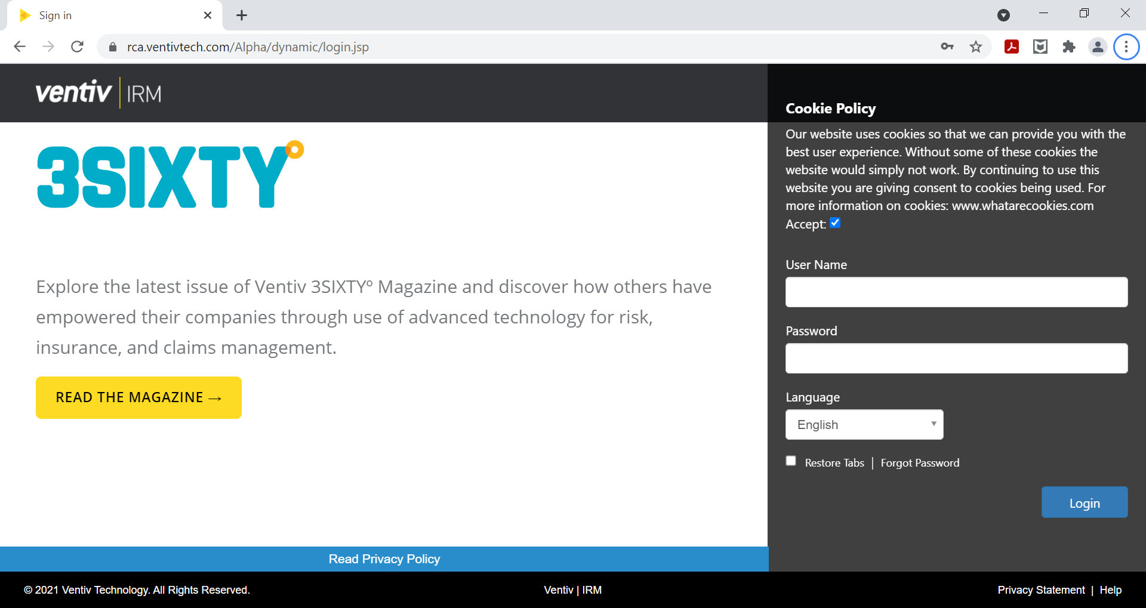
Accessing the Self-Evaluation
IRM – (Previously Risk Console)
  Log into IRM:
    https://rca.ventivtech.com/Alpha/dynamic/login.jsp
  If you do not have access to IRM please fill out this document:
    https://doas.ga.gov/assets/Risk%20Management/Operational%20Documents/RMS%20Contact%20Access%20Form.pdf
    NOTE: each user that needs access will need to fill out a separate form
  Once complete please email the form to Nyota Reed.
    nyota.reed@doas.ga.gov
    Once the form is processed by DOAS; each user will receive an email with directions for completing the IRM account setup

Slide 9
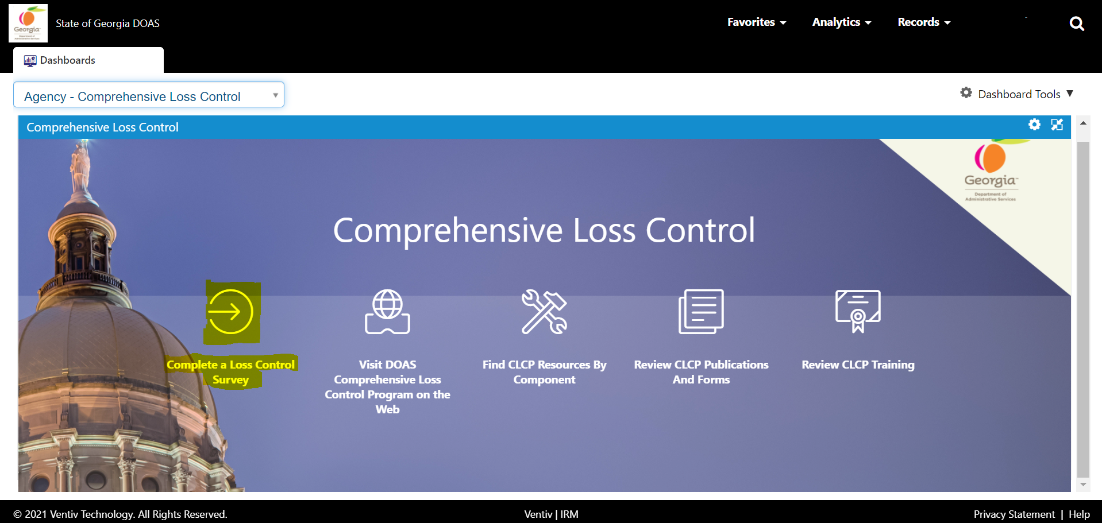
Accessing the Self-Evaluation
Self-Evaluation Form
  Once you are logged onto IRM
  Click “Complete a Loss Control Survey”

Slide 10
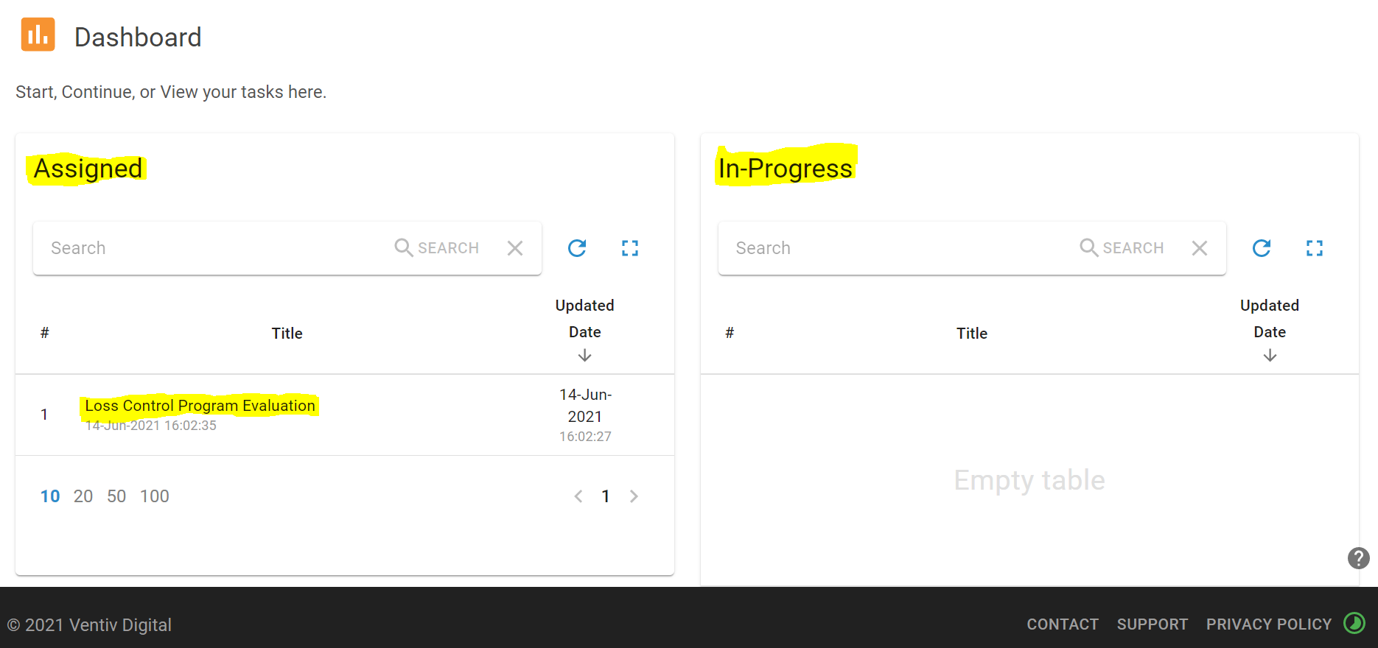
Self-Evaluation Assigned vs. In-Progress
Assigned
  Evaluations under the “Assigned” portion are newly assigned forms that has NOT been started.
  **If you are STARTING a NEW Evaluation; select the Evaluation located under “Assigned”
In-Progress
  Evaluations under the “In-Progress” are evaluations that are started but incomplete or delegated and have not been submitted.
  **If you are CONTINUING a previously started/saved Evaluation; select the Evaluation located under “In-Progress”

Slide 11
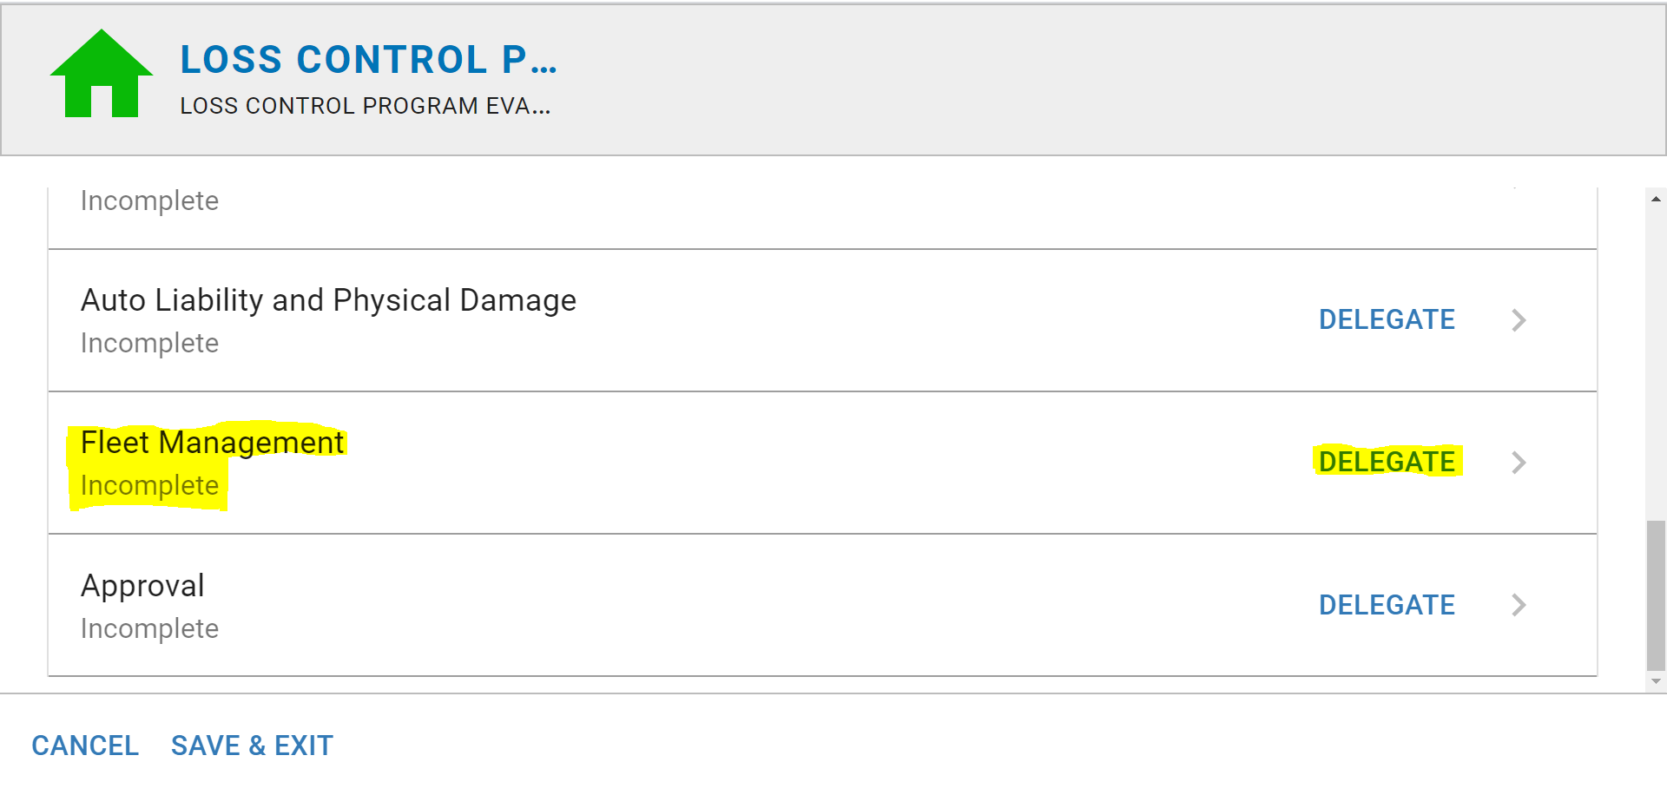
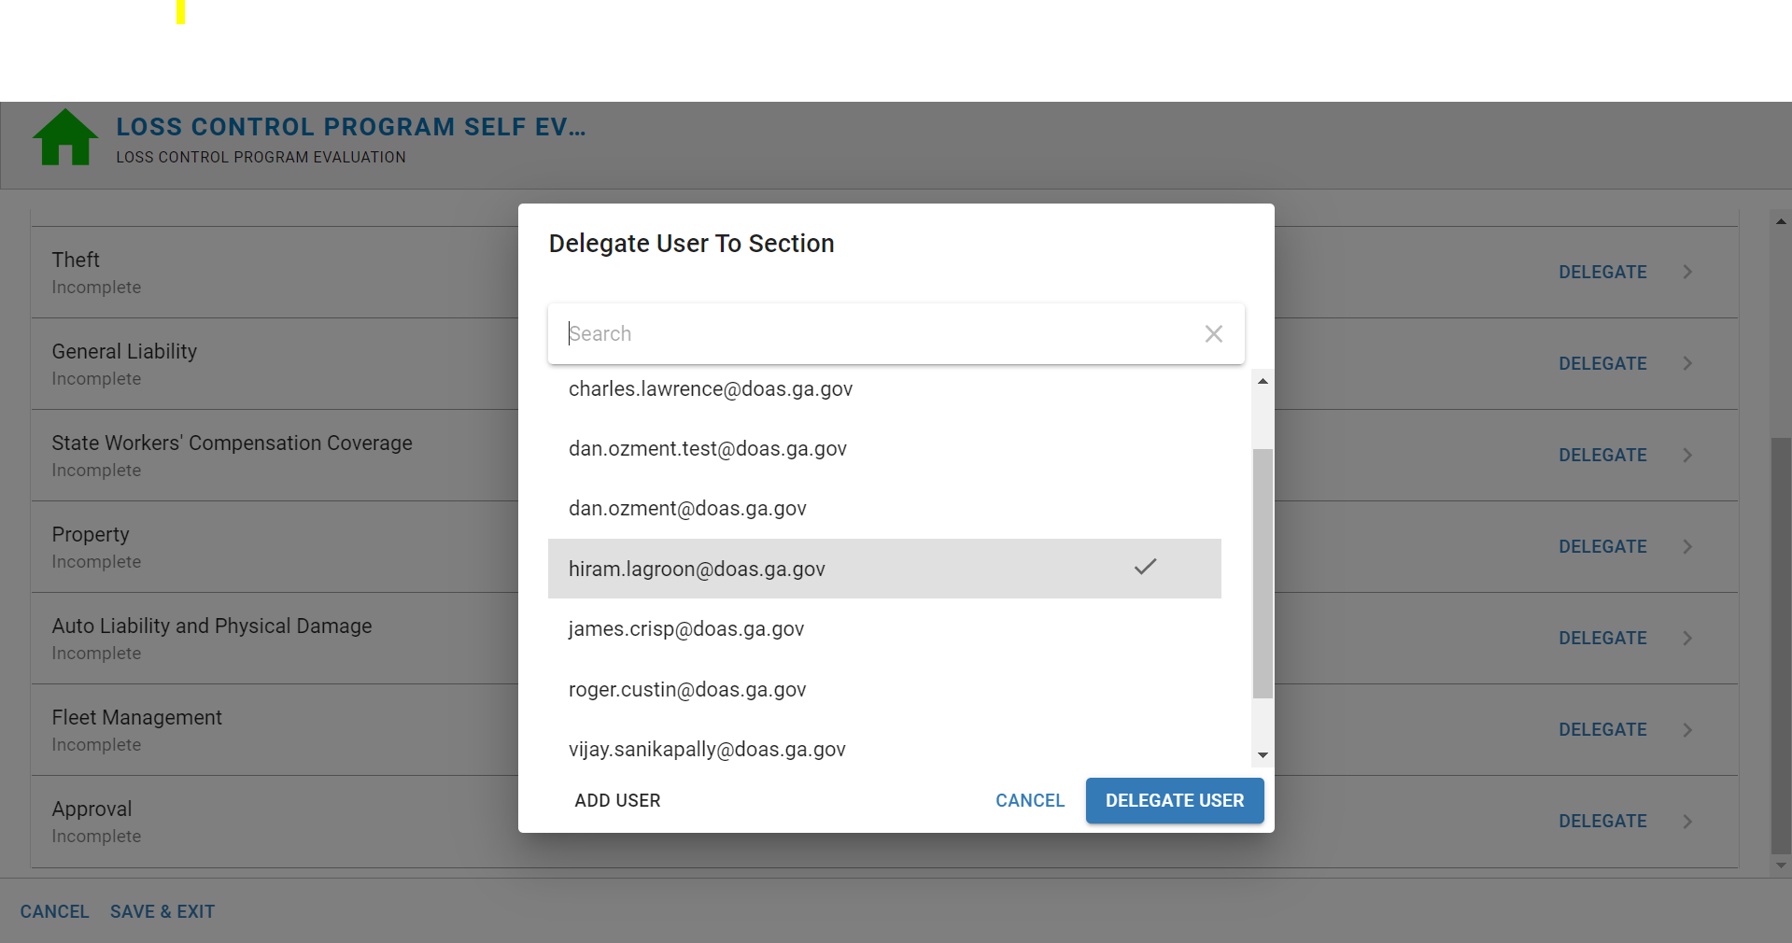
Risk Manager Coordinator and CLCP Self-Assessment tool
You as the Risk Manager Coordinator for your Entity, are responsible for coordinating the efforts at your Entity to gather the requested information.
This may mean you will need to Delegate a specific component to another Team member that would handle details of that specific “Self Evaluation Component”
EXAMPLE:
  I would like to Delegate or assign John Doe component 8 – Fleet Management as he is our agencies Fleet Manager.
    From the main menu, scroll down to Fleet Management
    Click Delegate on the far right of the row
    Scroll down to the team member’s email and select
    Then select Delegate User at the bottom right of the pop-up
    John Doe should now be able to see his Delegated portion of the Evaluation under the “In Progress” section when he navigates to the Self Evaluation Dashboard. (Refer to slide 8-10)

Slide 12
Delegation Details
***IMPORTANT***
Users DO NOT automatically populate in the delegation drop down section.
A user that needs to be delegated a section must FIRST log into IRM then Navigate to the screen to the right (See slide 9-10) Once they get to this screen for the first time they can then close out this screen.
Now when the Risk Manager goes into the form, they will be able to see the email address of the user that is to be delegated a specific section. (see slide 11 for direction on delegation)

Slide 13
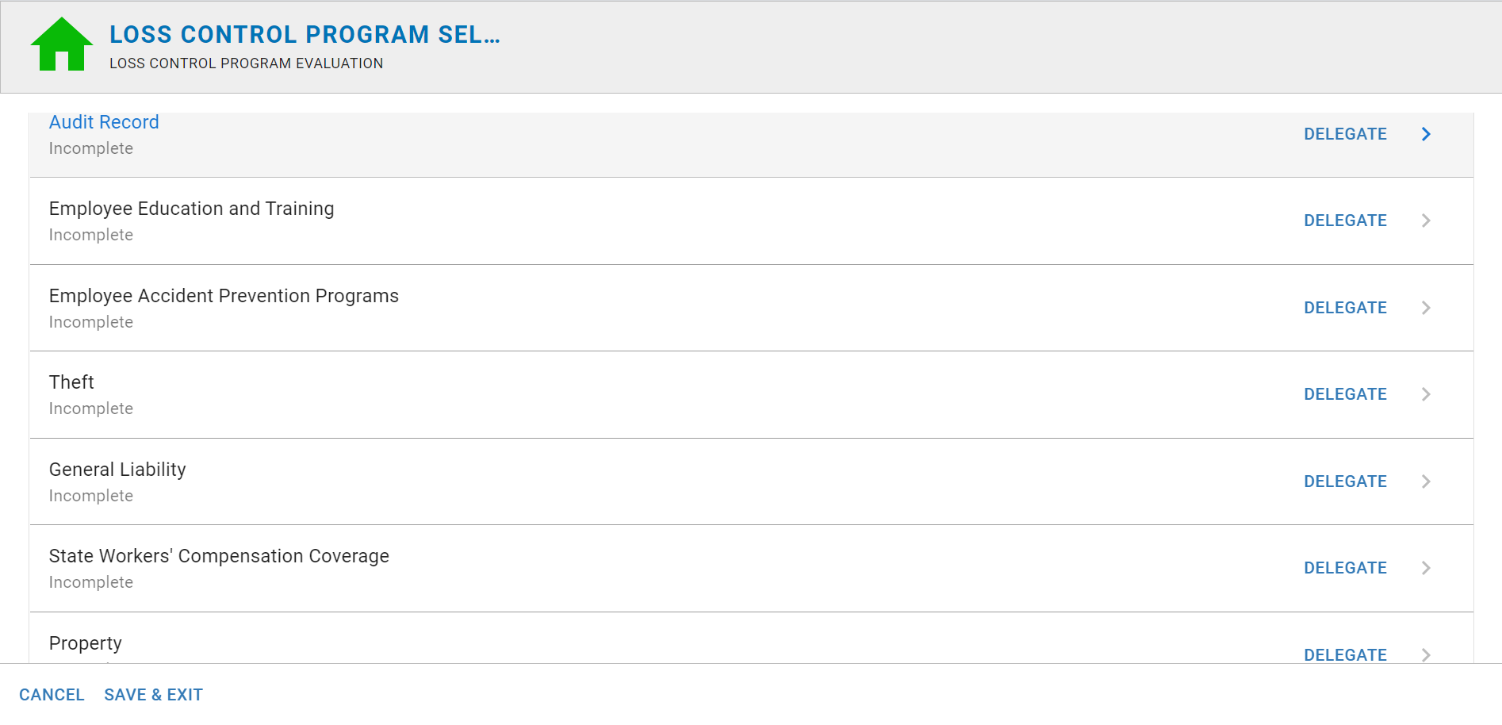
CLCP Self-Evaluation
The Self-Evaluation is comprised
of 8 components with 24 questions
in total:
Employee Education and Training
Employee Accident Prevention Program
Theft
General Liability
States Workers’ Compensation
Property
Auto Liability and Physical Damage
Fleet Management

Slide 14
Self-Evaluation Main Menu
To start a NEW Evaluation for your agency:
Click the Audit Record from the main menu page

Slide 15
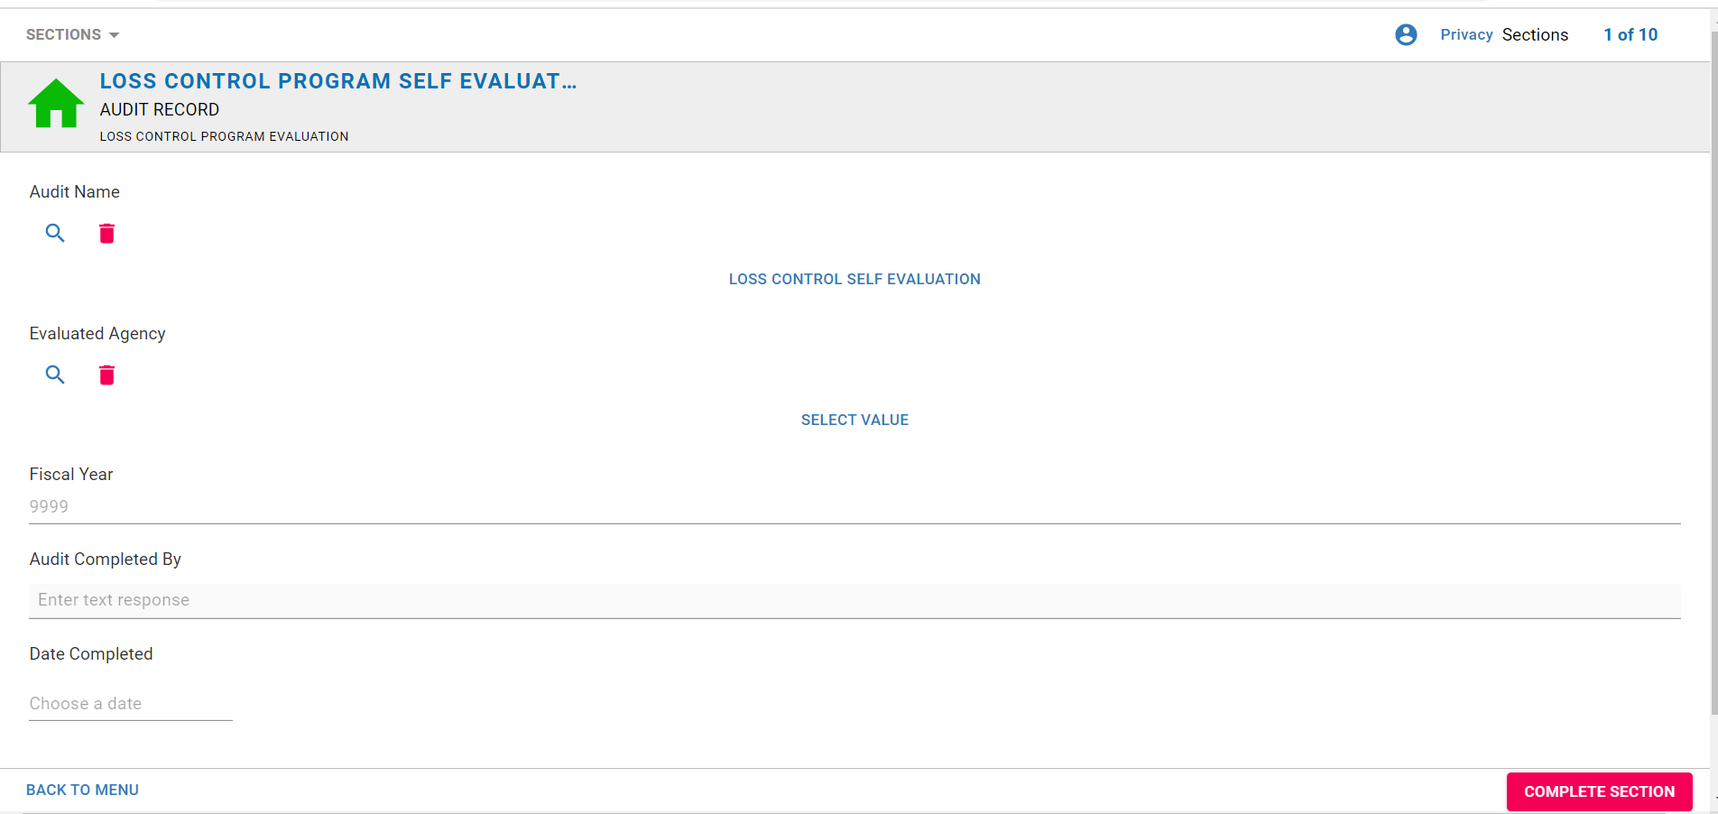
Audit Records
To start a NEW Evaluation for your agency:
Click Audit Name
  Select Loss Control Self Evaluation
Click Evaluated Agency
  Scroll down to your agency and select
Enter the Fiscal Year
4. Enter who the Audit is completed by
5. Enter Date
6. Complete Section – Once selected you will be taken back to the Self Evaluation main page
1
2
3
4
5
6

Slide 16
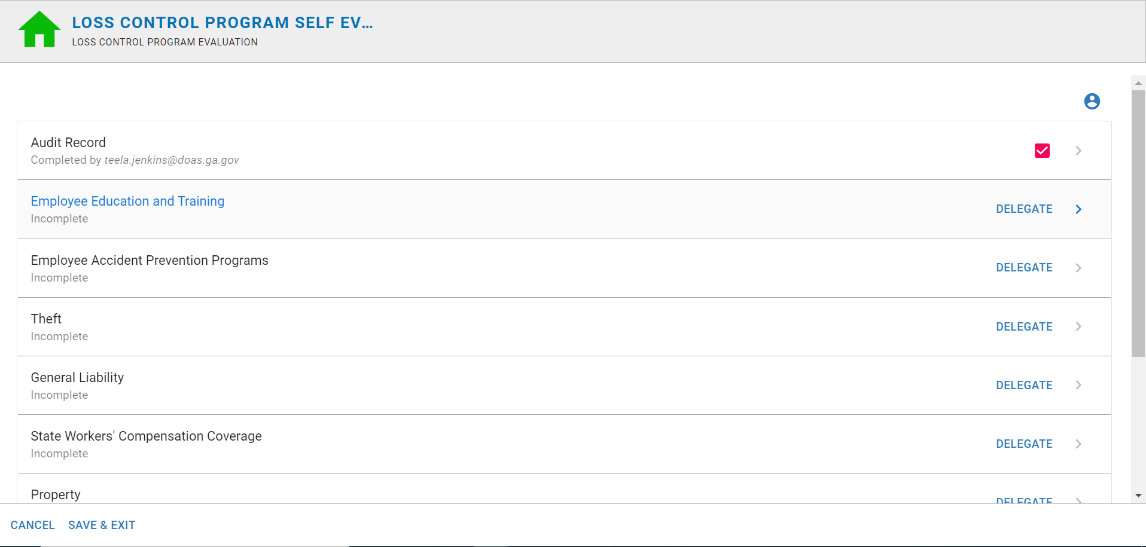
Completing the Self Evaluation
  Select the “component” that you would like to work on from the main menu.

Slide 17
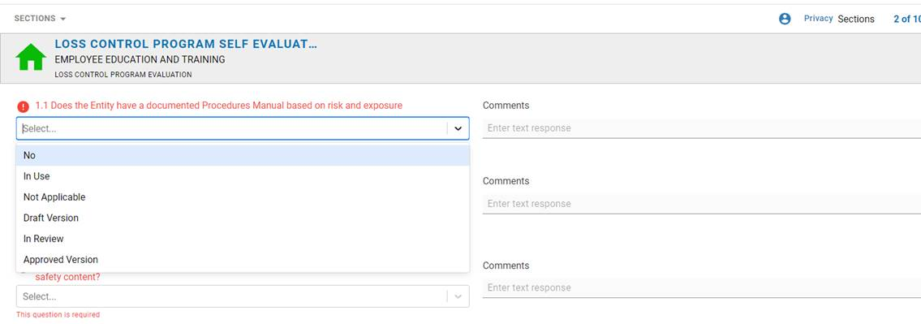
Completing the Self-Evaluation
Select the drop down to answer each question
Answer the question by indicating the status of the Entities documentation and implementation.
  N/A- the question is not applicable to your Entity’s objective or operations
  No- Your entity does not have the documentation, policies or Procedures. That are being reviewed by the Entity’s Leadership.
  Draft Version- The Entity has a draft version documentation, policies or procedures to support this question
  In Review- The Entity has documentation, policies or procedures that are being reviewed by the entity's Leadership
  Approved Version- The Entity has documentation, policies or procedures that have been approved by the entity’s leadership but have not been distributed or implemented yet.
  In use- The Entity has documentation, Policies, and Procedures that are in place and in use.

Slide 18
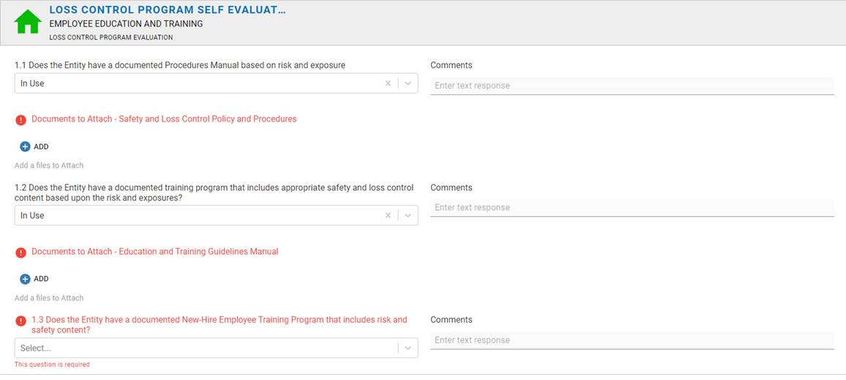
Completing the Self Evaluation
  You will be brought into the component to answer 3 corresponding questions and provide the supporting documentation to satisfy each question.

Slide 19
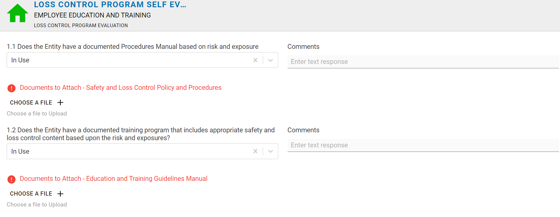
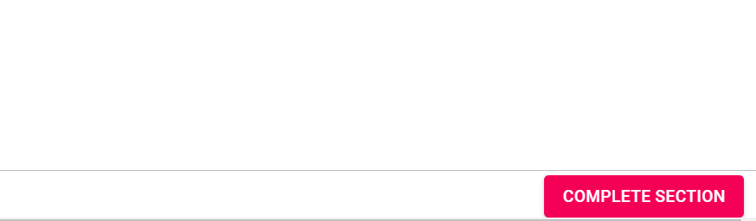
Completing the Self-Evaluation
Enter any comments that are applicable to your answer
Attach supporting documentation to satisfy each question.
Once all questions are answered you will be able to complete the section

Slide 20
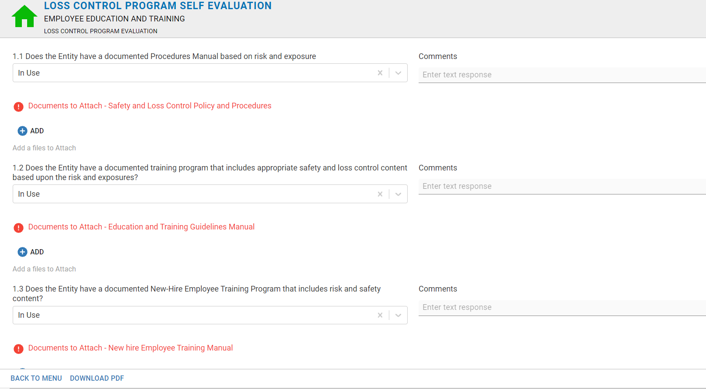
Component 1: Employee Education and Training

Slide 21
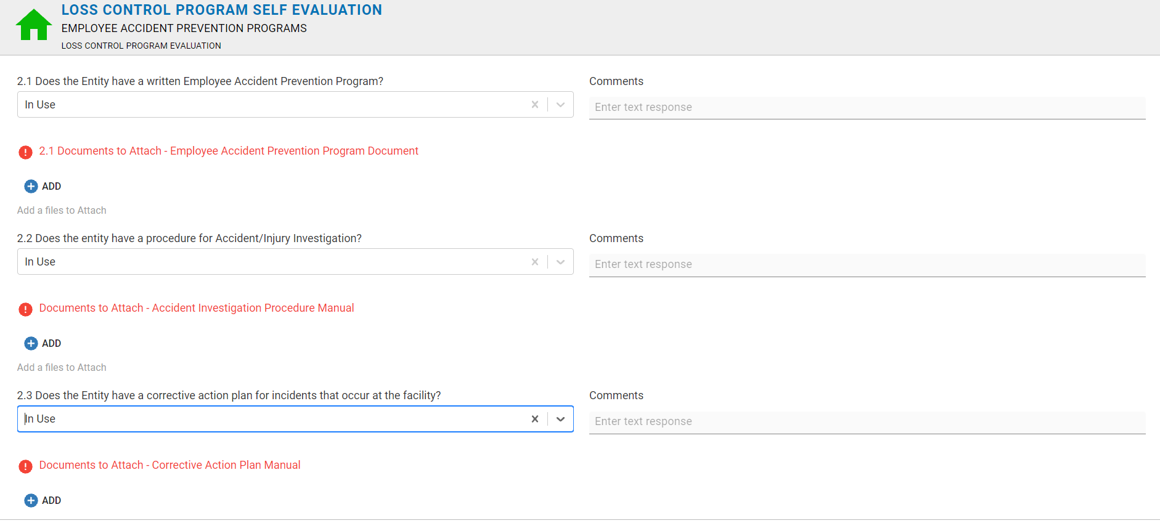
Component 2: Employee Accident Prevention Program

Slide 22
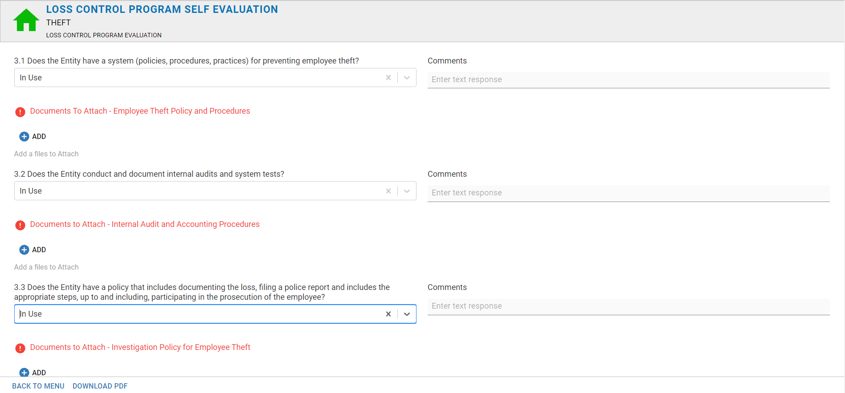
Component 3: Theft

Slide 23
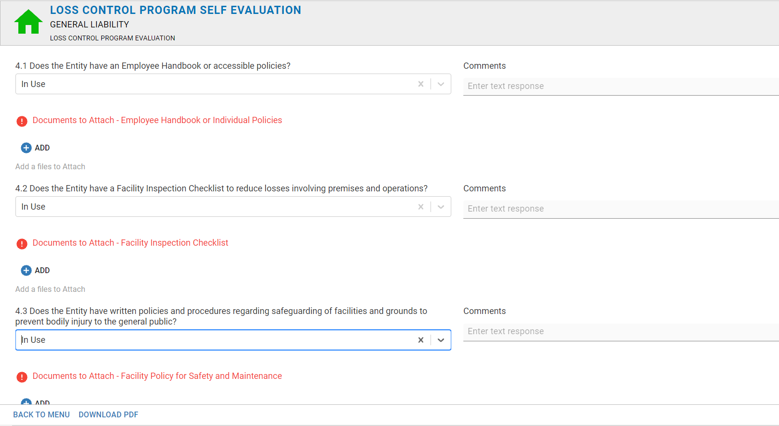
Component 4: General Liabilty

Slide 24
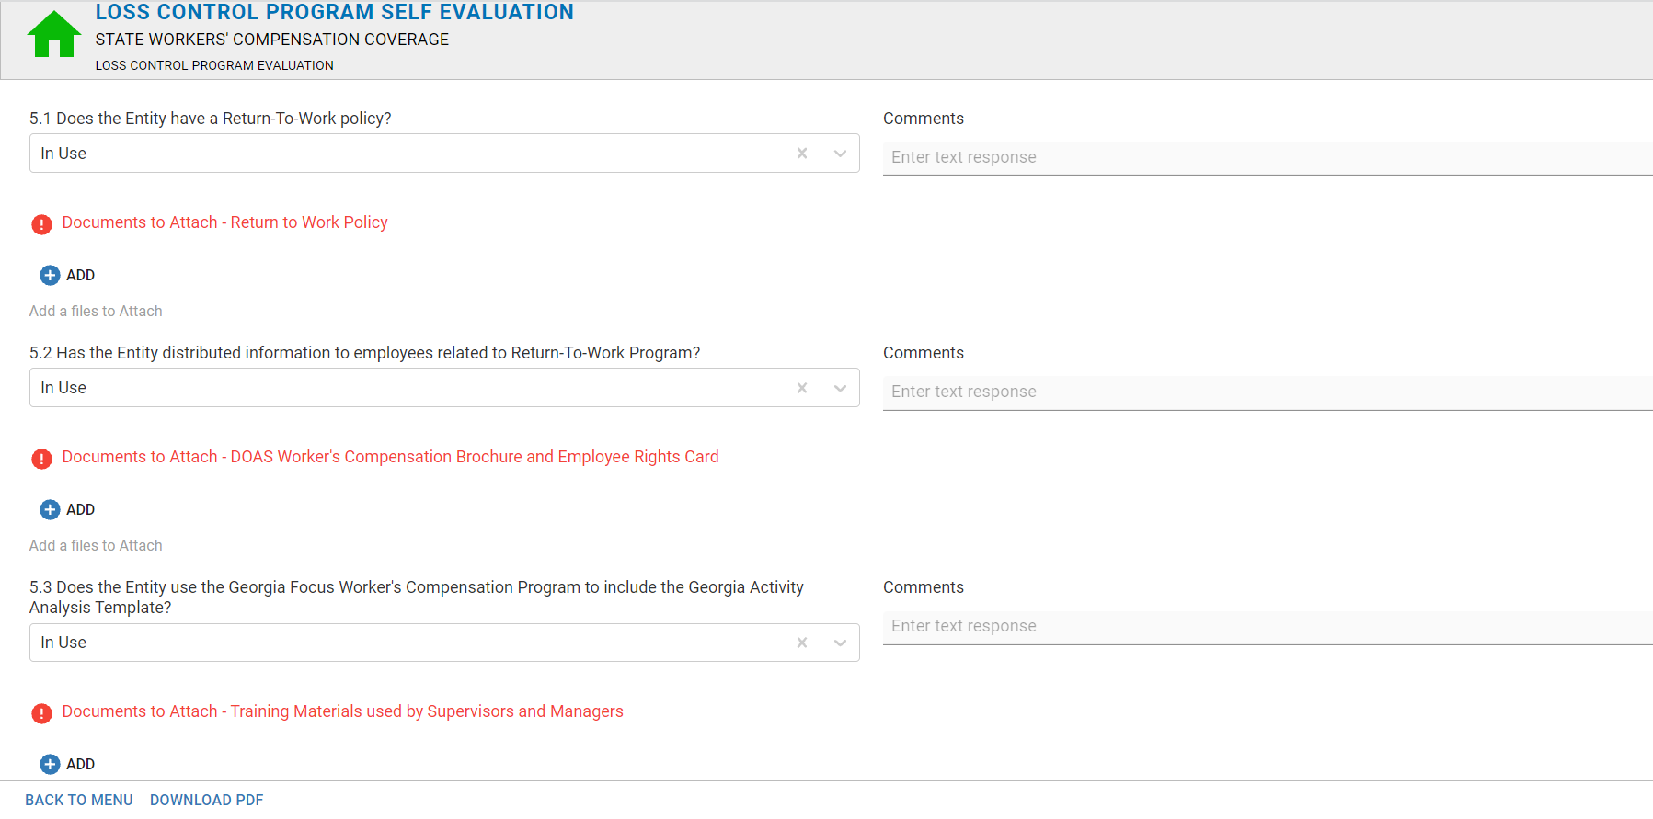
Component 5: State Workers’ Compensation

Slide 25
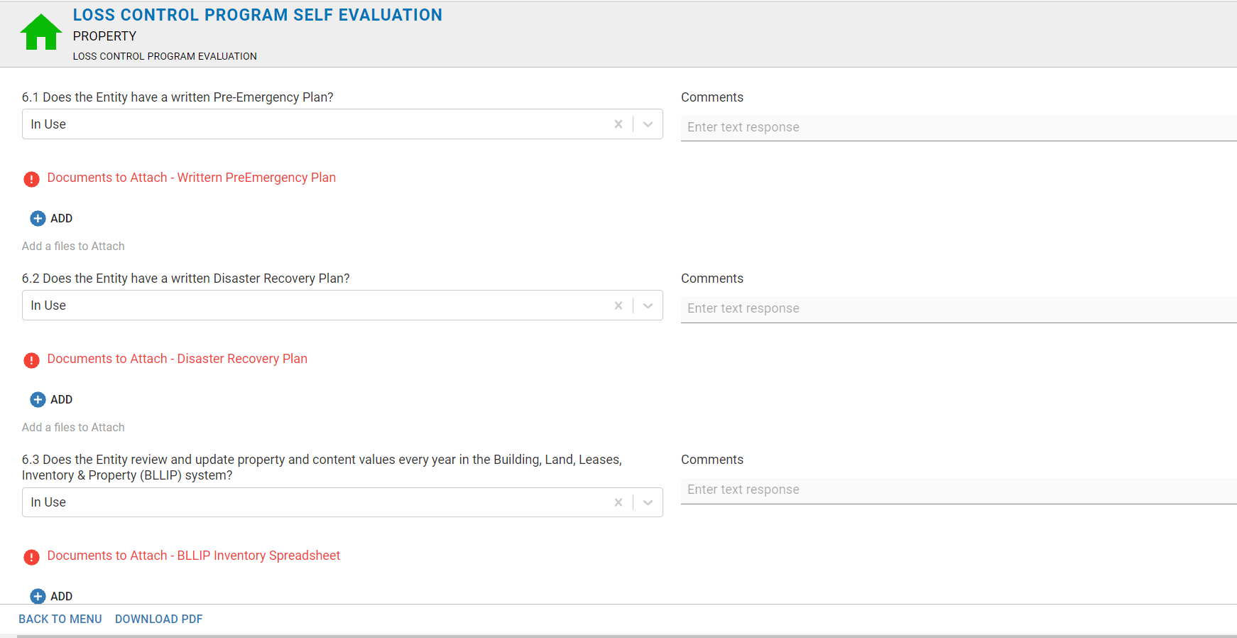
Component 6: Property

Slide 26
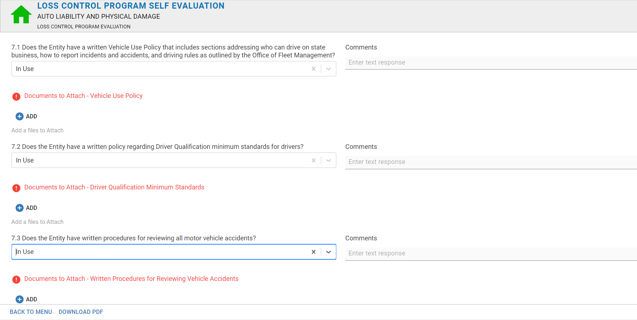
Component 7: Auto Liability and Physical Damage

Slide 27
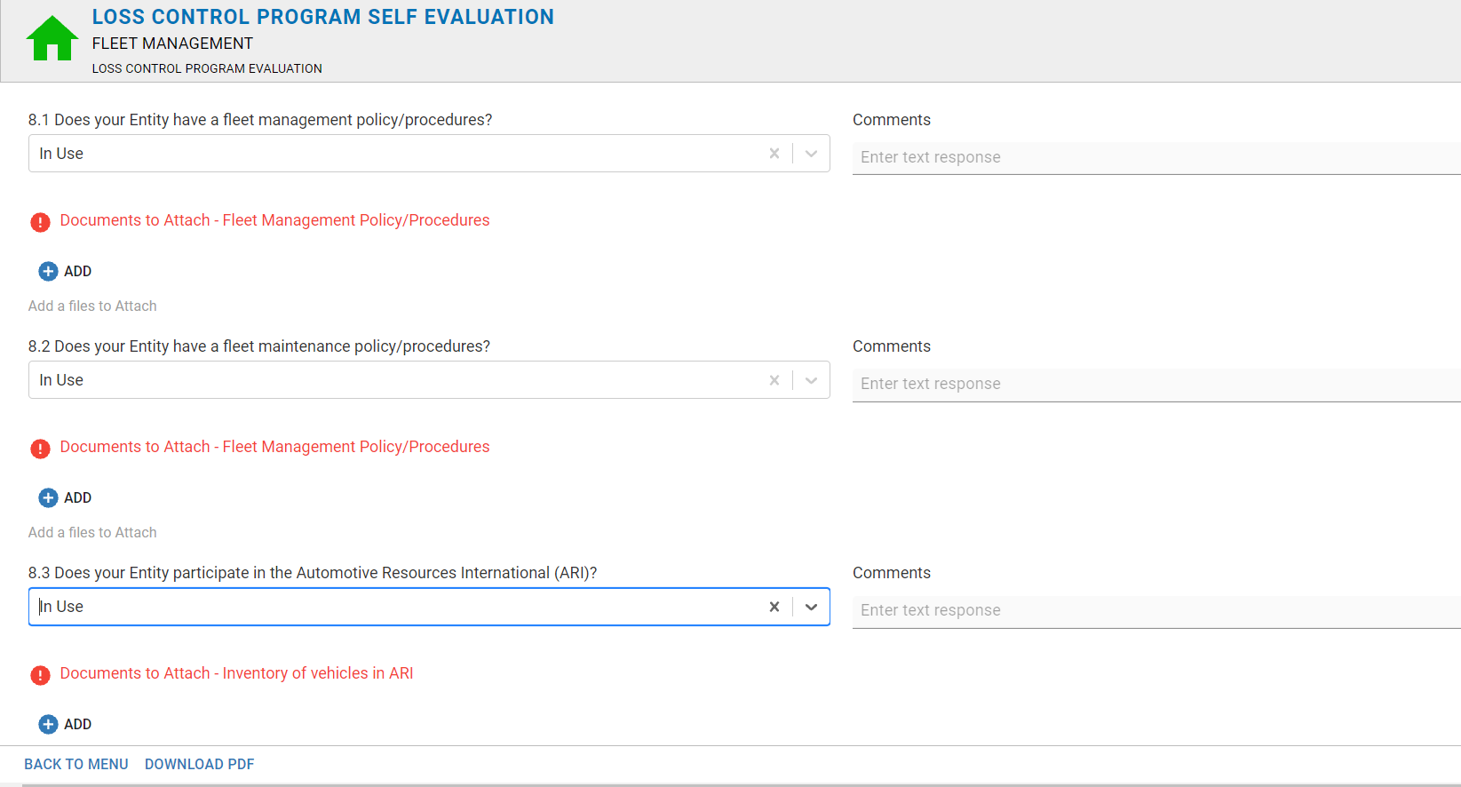
Component 8: Fleet Management

Slide 28

Using IRM
IRM- A (free) tool provided to all agencies to assist with reviewing:
  Frequency of Claims
  Types of Claims
  Severity (Costs) of Claims
IRM Claim Reviews assist with agency development of:
  Preventive Actions
  Awareness Programs
  Training Plans should be in place to address the TOP 3 types of claims annually.

Slide 29
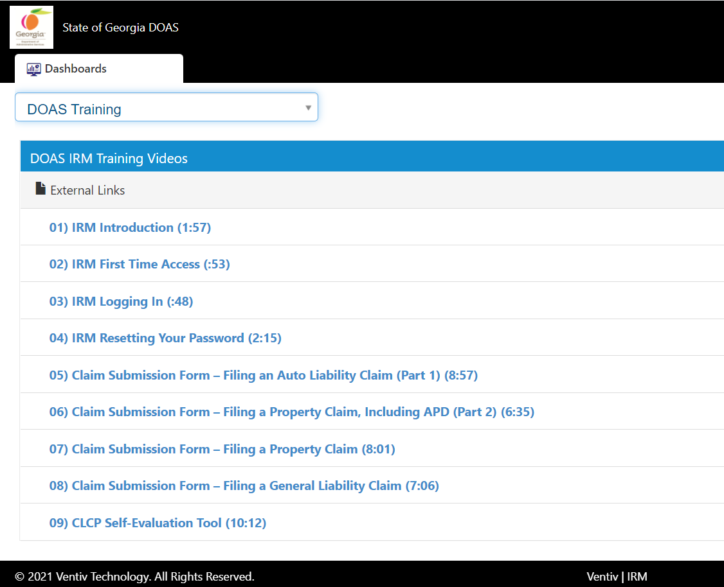
IRM Training Videos
For additional IRM how to videos. Click the drop down on your IRM Dashboard:
Scroll down to DOAS Training
Select the training link as needed

Slide 30
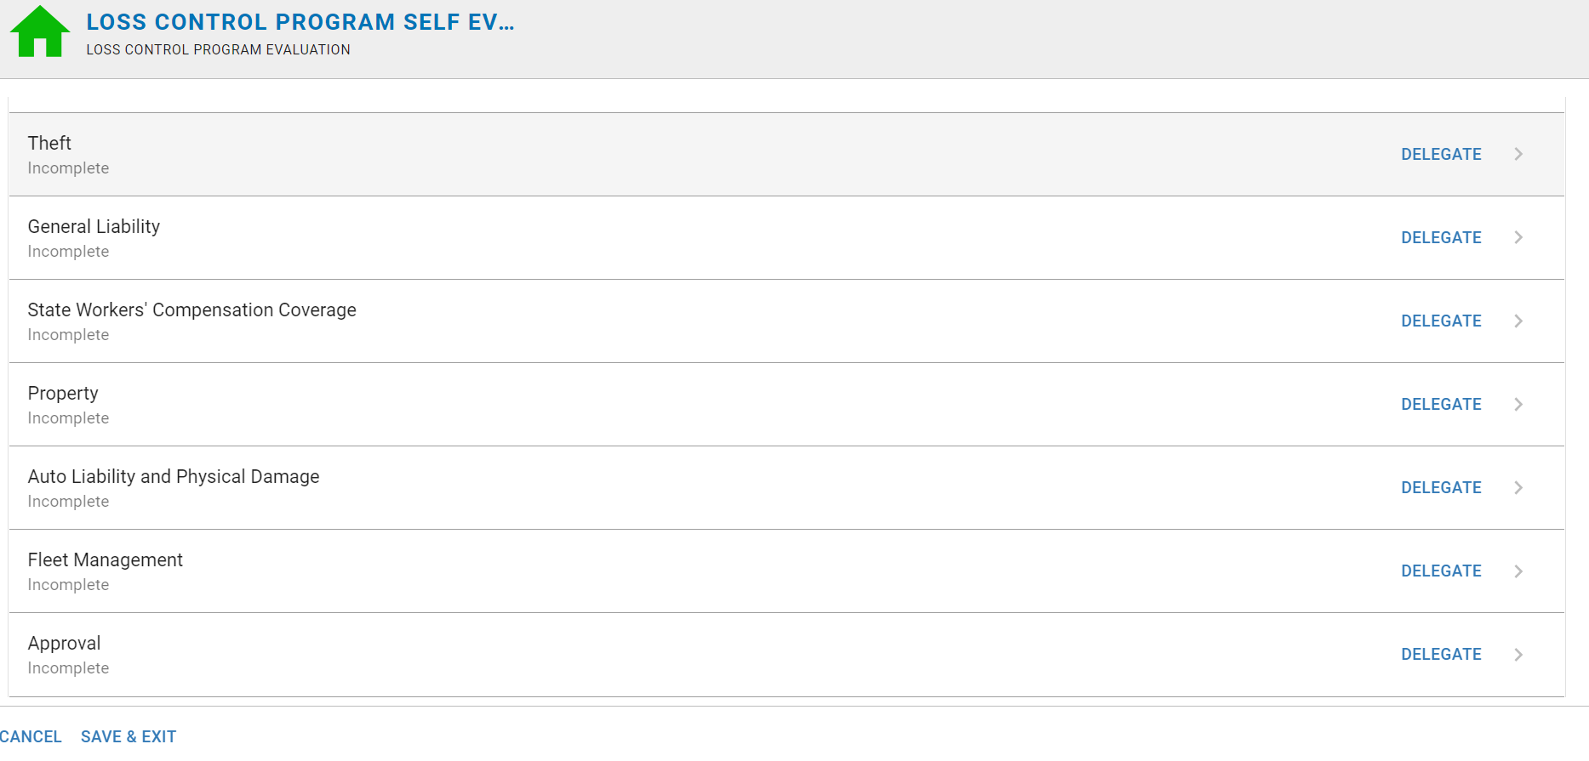
Self-Evaluation Main Menu
Continue the same steps for all 8 components
As you navigate through the Self Evaluation; ensure that you save before exiting in the event you need to come back to the form.
Also avoid using the back button on your internet browser. To return to the pictured screen. Please use the “Back to Menu” button on the bottom left.
Once all 8 components are complete. Select the “Approval” section.

Slide 31
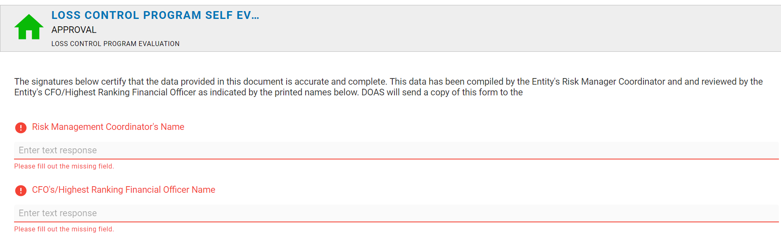
Completing the Self-Evaluation
Once you have answered all 24 questions and attached all supporting documentation
CFO (or highest-ranking financial officer) for your Entity Print his/her name to acknowledge the review of the completed Self Evaluation’s content.
The agency’s Risk Management Coordinator will also need print his/her name to acknowledge the review of the completed Self Evaluation’s content.

Slide 32

CFO Approval Details
***IMPORTANT***
Only the user that STARTED the evaluation will be able to see the entire evaluation form.
For the CFO to review the entire form and the attachments there are 2 options:
  Option 1: The Risk manager and the CFO can set up a meeting to review the evaluation together under the Risk Managers profile.
  Option 2: The Risk Manager can delegate all sections of the form to the CFO. So that the CFO can review each section on their own account
The Approval Section Must Be delegated to the CFO regardless; so that the CFO can sign off on the form after the review.

Slide 33
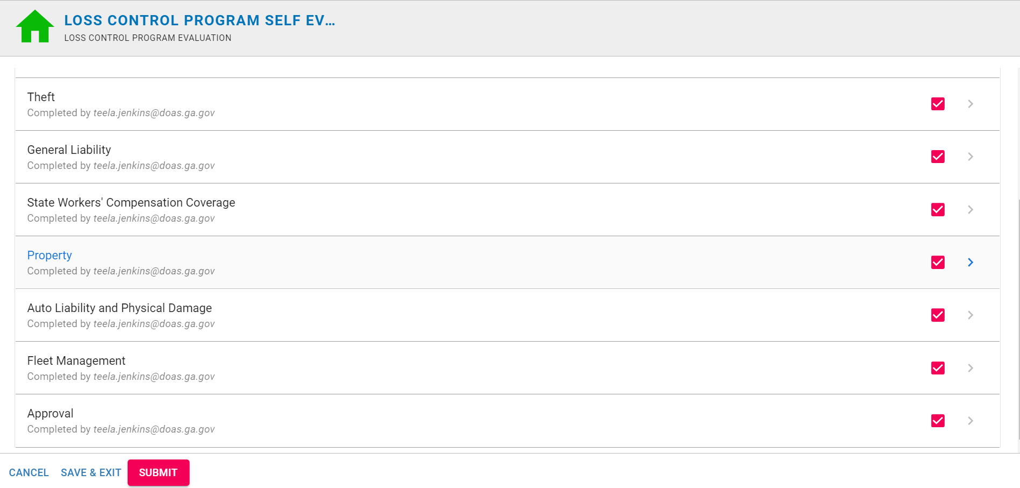
Completing the Self-Evaluation
Once you have answered all 24 questions, attached all supporting documentation,
AND
The CFO and Risk Management Coordinator have completed the Approval section.
Submit the completed Evaluation.
  You should receive a confirmation email shortly after the submission

Slide 34
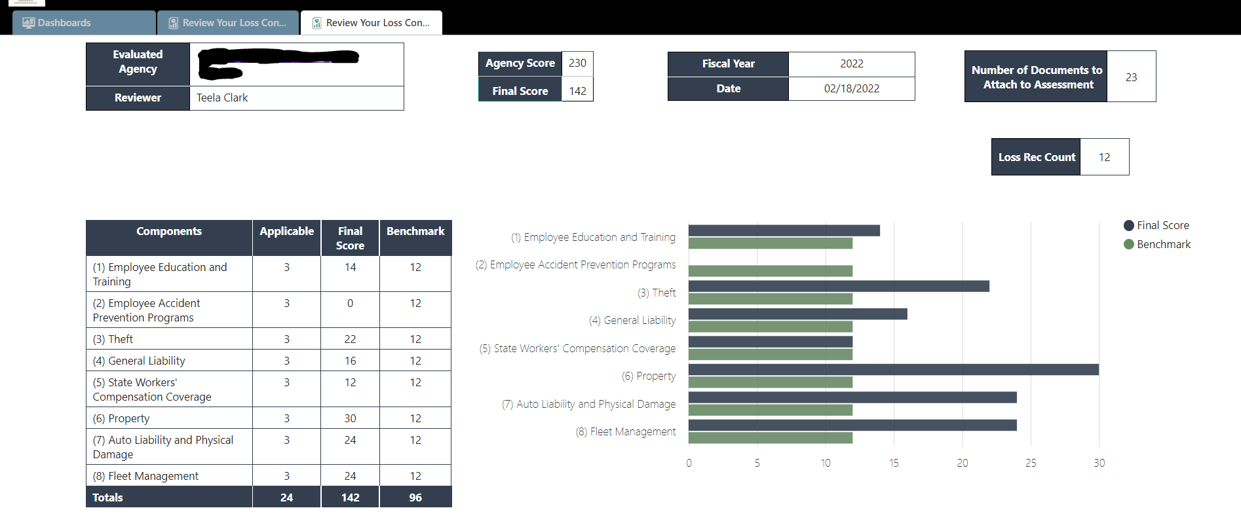
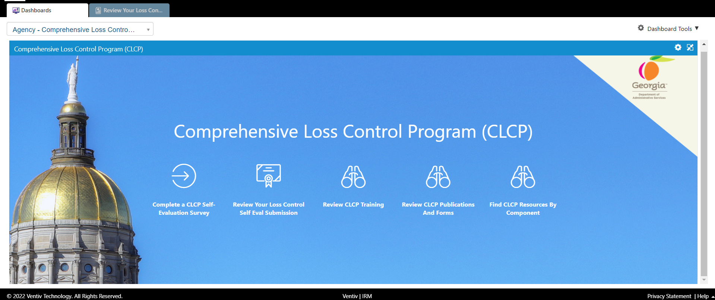
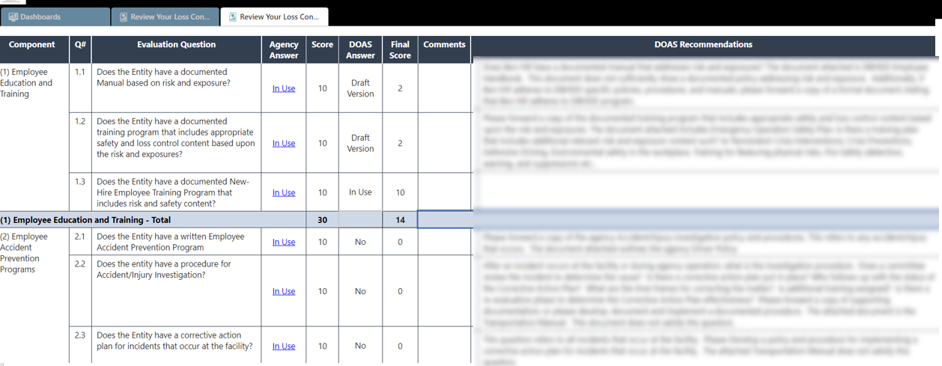
Agency - CLCP IRM Dashboard
“Review Your Loss Control Self Eval Submission” Icon:
  Will take you to a page that will display you agency’s results and recommendations.

Slide 35
“Review Your Loss Control Self Eval Submission” Icon:
1. Evaluated Agency: Your agency Name
Reviewer: Name of the DOAS Loss Control team member that reviewed the agency submission. Also, your best point of contact if you have any questions or concerns regarding your submission/recommendations.
2. Agency Score- The score the agency gave themselves
Final Score- The score DOAS gave the agency based on the review of the provided supporting documents
3. Fiscal Year of the submission
Date- current date
4. Number of Documents…: the minimum number of documents requested to attach.
Loss Rec Count- Number of Recommendations DOAS has for your CLCP program based on the supporting documents provided.
5. The Table displays a summary of your submission with you FINAL Score and Benchmark
Benchmark shows the acceptable minimum score for each question for all agencies. (all agencies are held to the same Benchmark expectation.
6. Bar chart of your agency score and the statewide Benchmark expectation.
1
2
3
4
5
6

Slide 36
“Review Your Loss Control Self Eval Submission” Icon:
In this section you will find a table that includes:
All 24 questions
The Answer and Score the agency gave themselves
The comments the agency provided
The Answer and FINAL Score DOAS gave the agency based on the supporting documents provided
DOAS Recommendations: the recommendations DOAS has for your agency CLCP program based on the documents provided

Slide 37
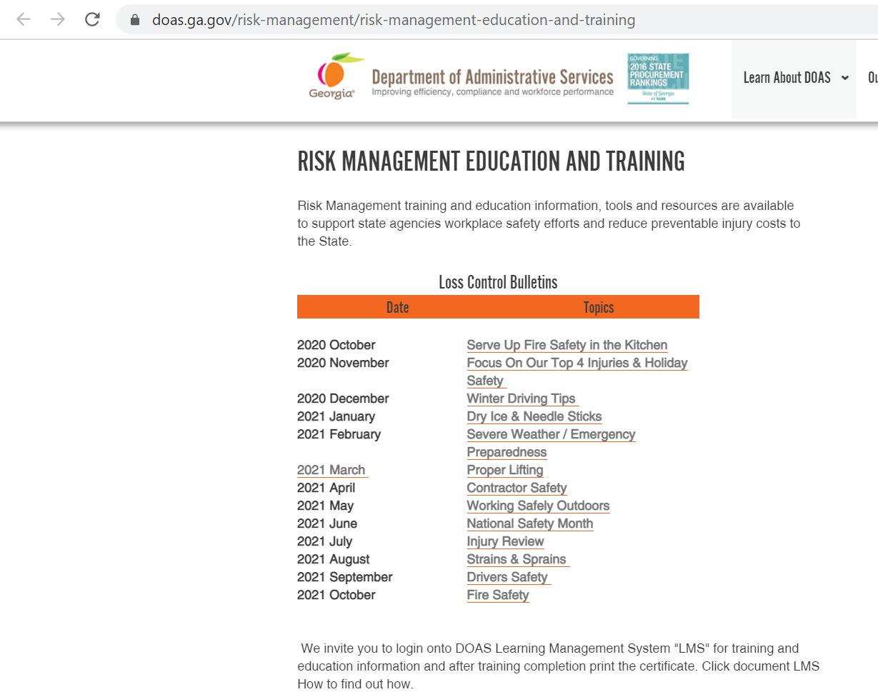
Agency - CLCP IRM Dashboard
“Review CLCP Training” Icon
  Will take you to DOAS website which provides information on Risk Management training and education tools and resources to support state agencies workplace safety efforts and reduce preventable injury cost to the state

Slide 38
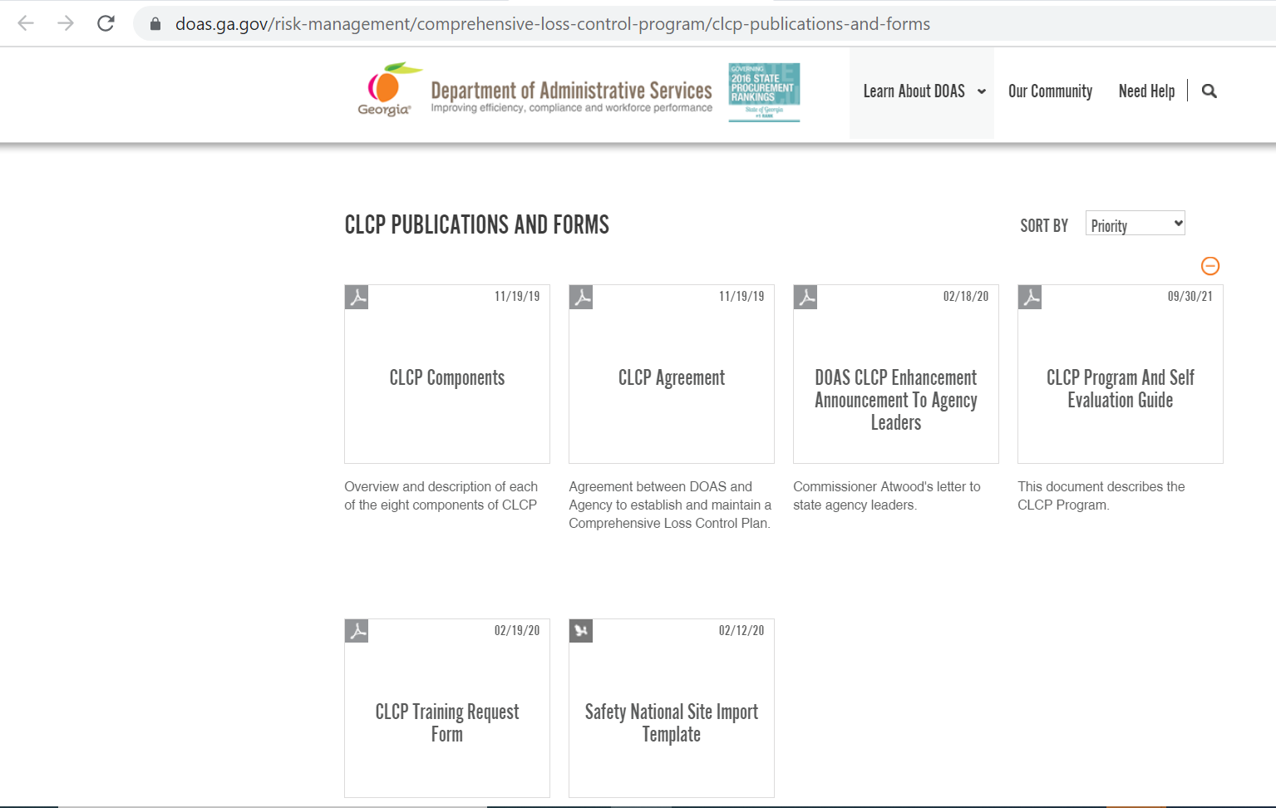
Agency - CLCP IRM Dashboard
“Review CLCP Publications and Forms” Icon:
  Will take you to DOAS website which provides information about CLCP Publications and Forms

Slide 39
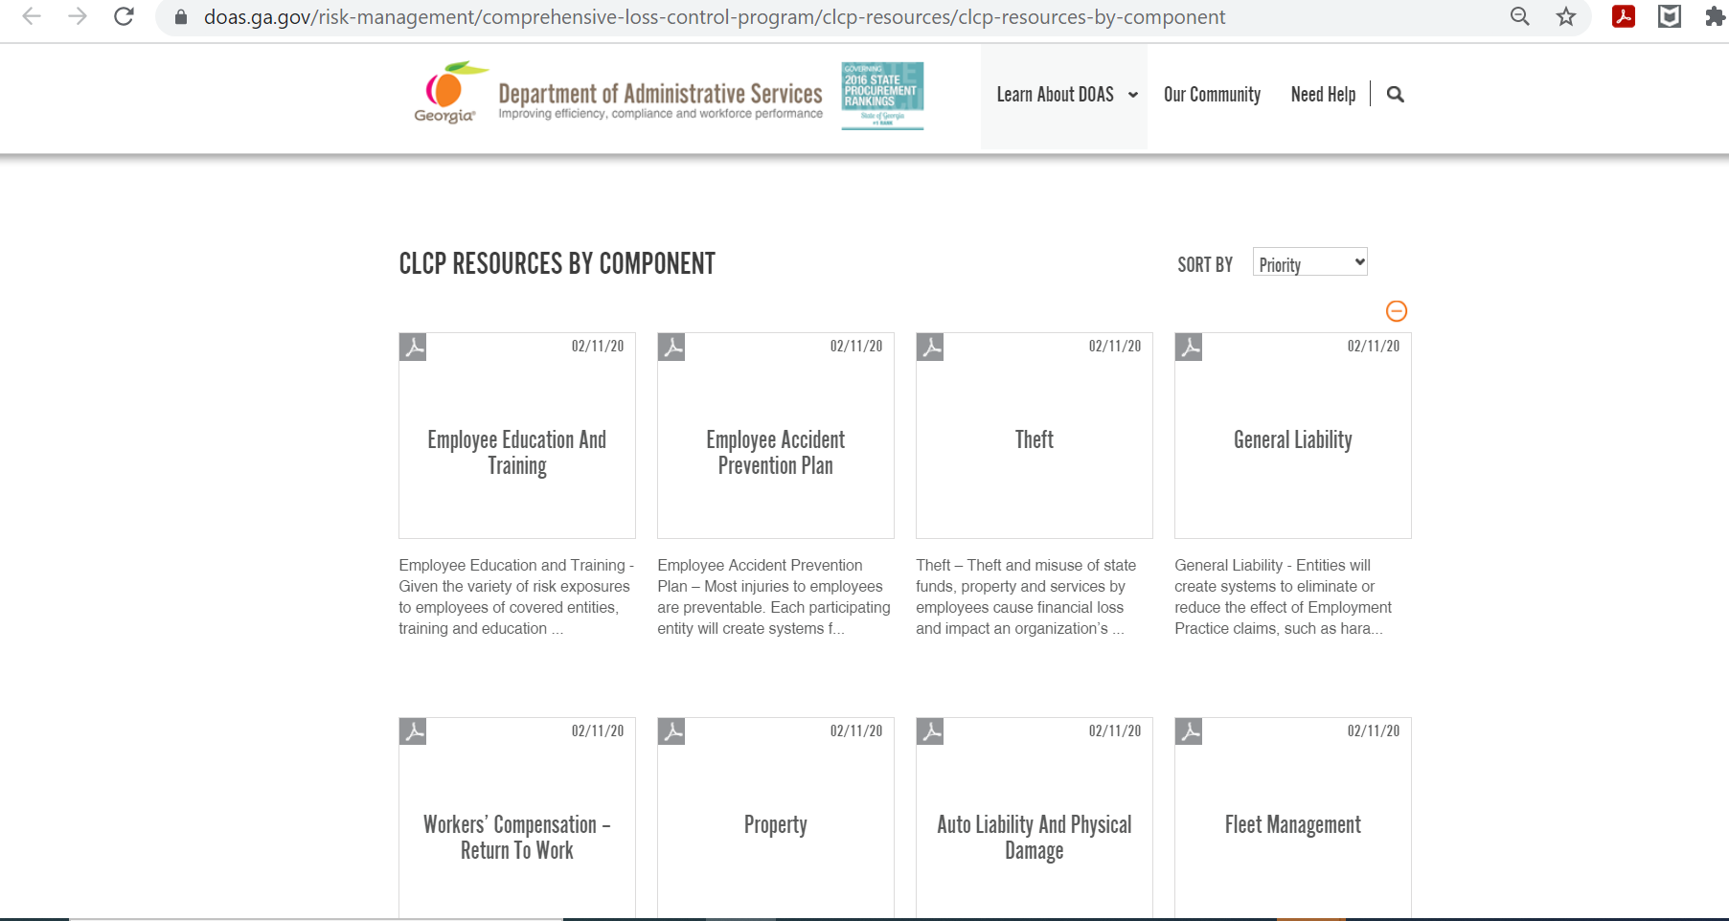
Agency - CLCP IRM Dashboard
“Find CLCP Resources By Component” Icon:
  Will take you to DOAS website which provides additional information about the CLCP program by component

Slide 40

On-site Visits Weighted Evaluation
Onsite visits:
  Are in-depth reviews of the agency Comprehensive Loss Control Components’ documents, policies and procedures.
  Visits will be conducted by DOAS Loss Control Department based on the agency Self-Assessment Tool scores.
  All Agencies that receive an onsite visit will also receive a weighted evaluation report immediately following the visit from DOAS Loss Control Department.
The Weighted Evaluation report will consist of the following:
    Document the Risks
    Component Evaluation: Includes, site audits, BLLIP audits, etc.
    Claim Review
    Recommendations
    Follow-up within 90 days
Weighted Evaluation

Slide 41

CLCP Contact Information
Hiram Lagroon
Chief Loss Control & Safety Officer
Hiram.lagroon@doas.ga.gov
(404) 463-6309
C.G. Lawrence
Chief Loss Control & Safety Officer
Charles.lawrence@doas.ga.gov
(404) 657-4457
Teela Clark
Loss Control & Safety Officer Teela.Clark@doas.ga.gov
(404) 656-5451
James Crisp
Loss Control & Safety Officer James.Crisp@doas.ga.gov
(404) 656- 9482

